Slide 1
SPRINT 1 Group 2
Lokesh G P
Sparsh Narania
Rakshit Jain
Padma Chospel
Nachiket Vijay

Slide 2
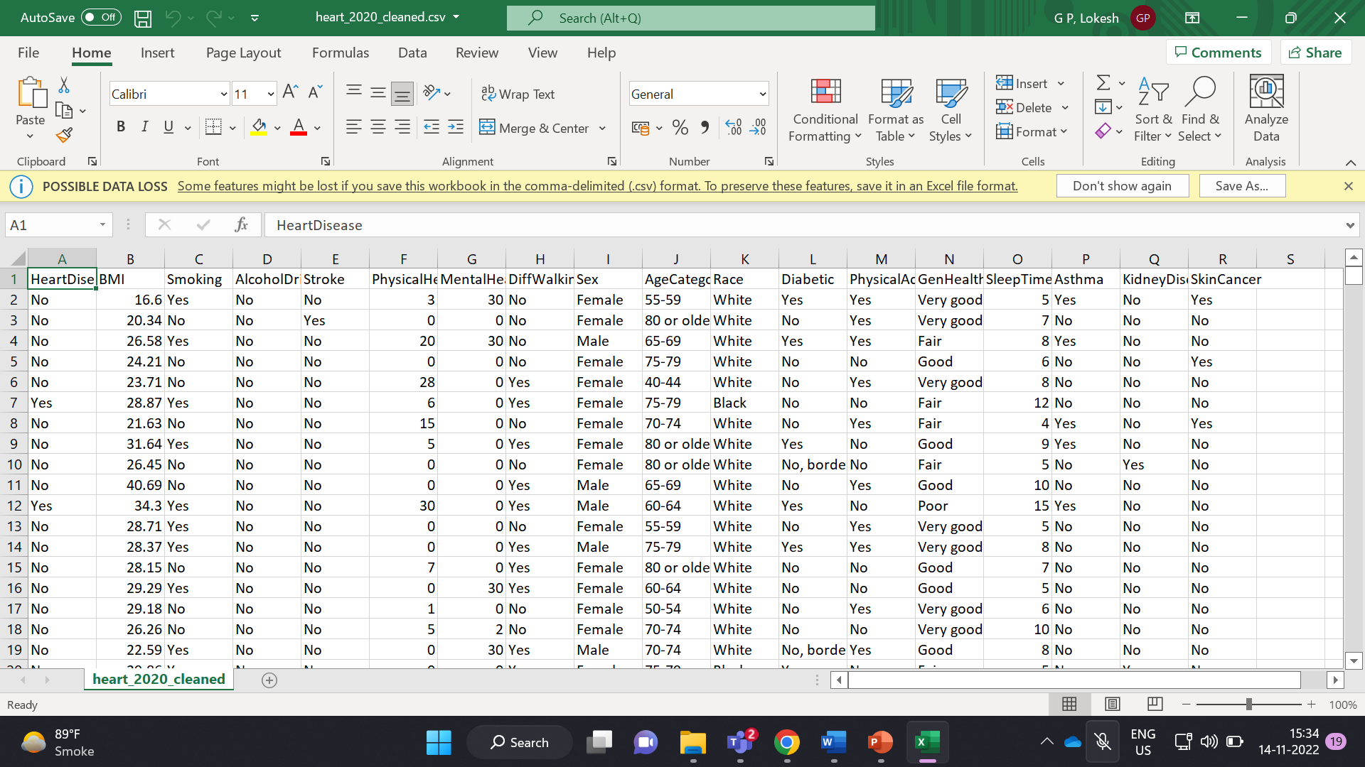
Dataset : heart_2020_cleaned

Slide 3
Task
To load data in Amazon S3 bucket.
To configure policy and creation of roles.
Using Snowflake as cloud compute medium.
Loading data from Amazon S3 to Snowflake database.
Query commands for the case questions.

Slide 4
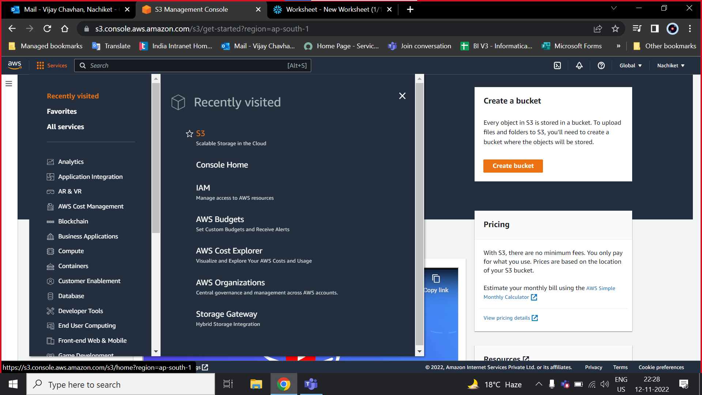


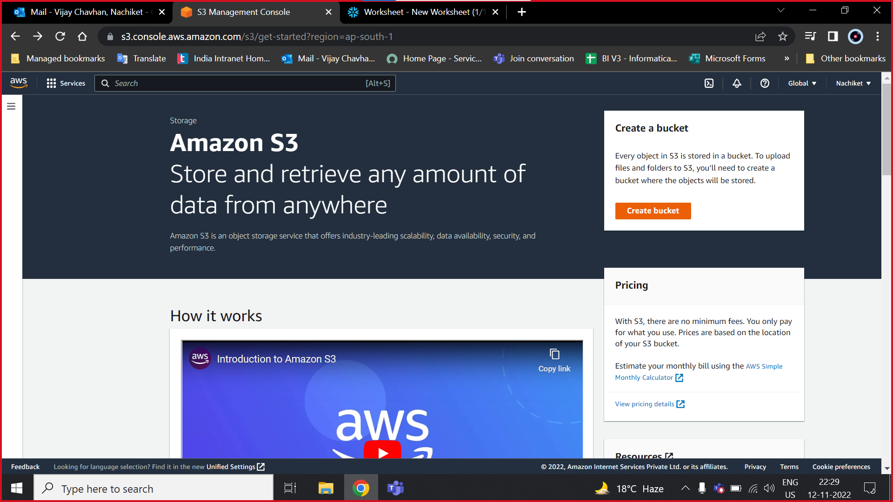


Slide 5
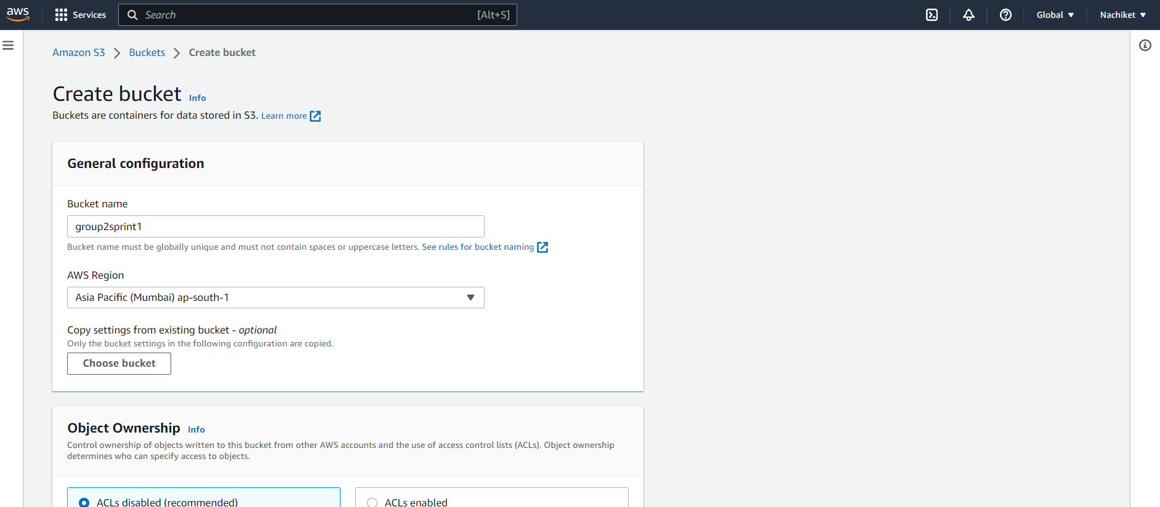
Creating a bucket:
Effect of region
Access control
Free access

Slide 6
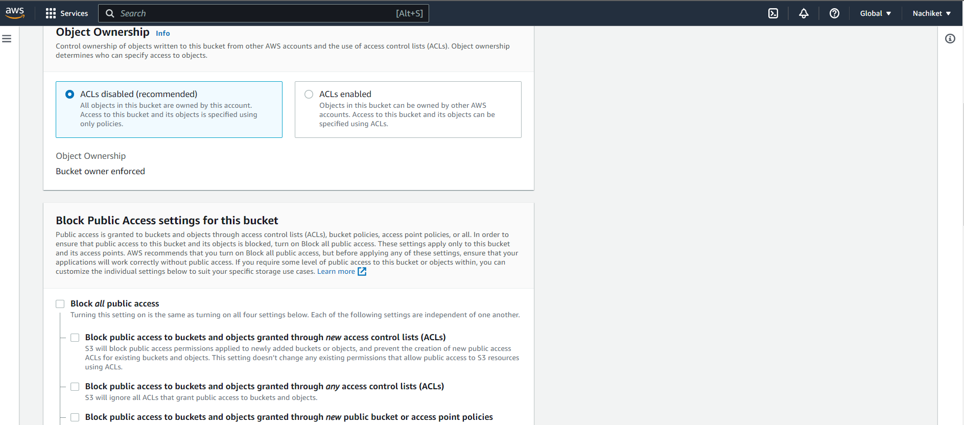

Slide 7
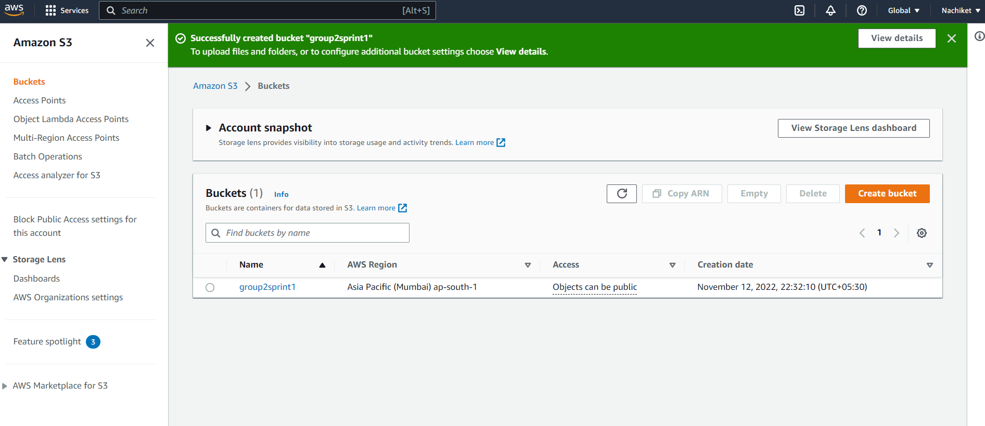

Slide 8
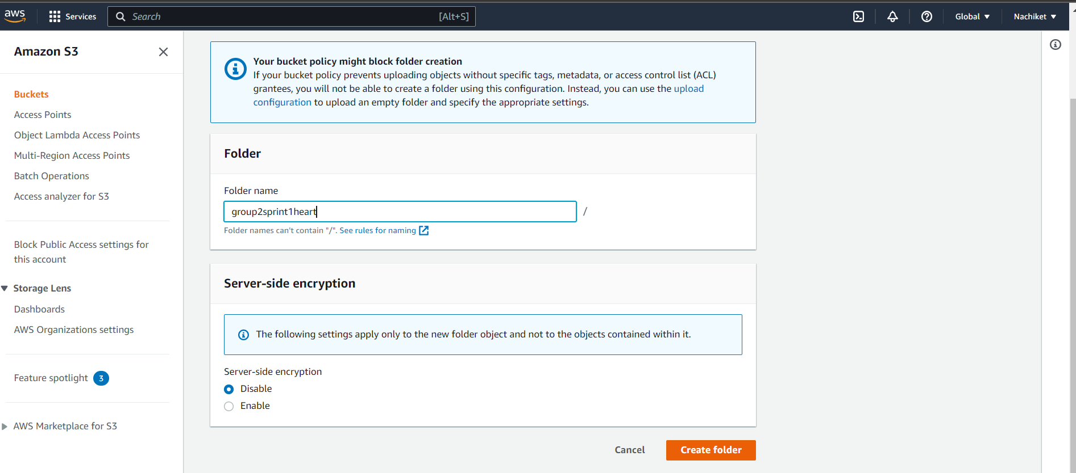

Slide 9
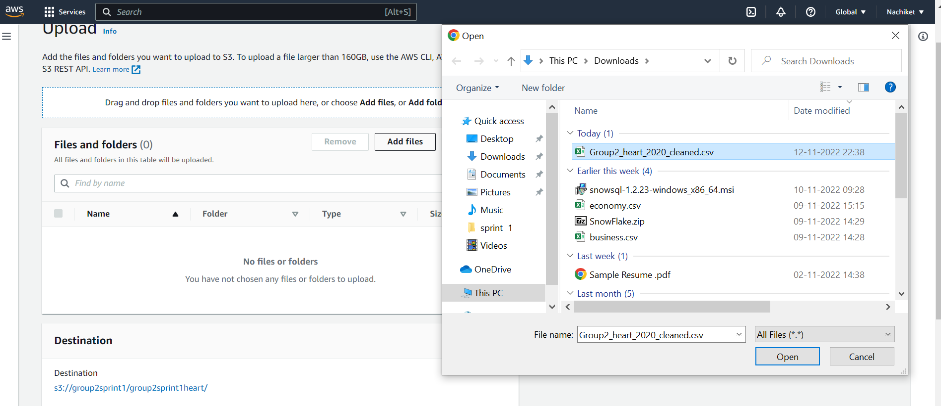

Slide 10
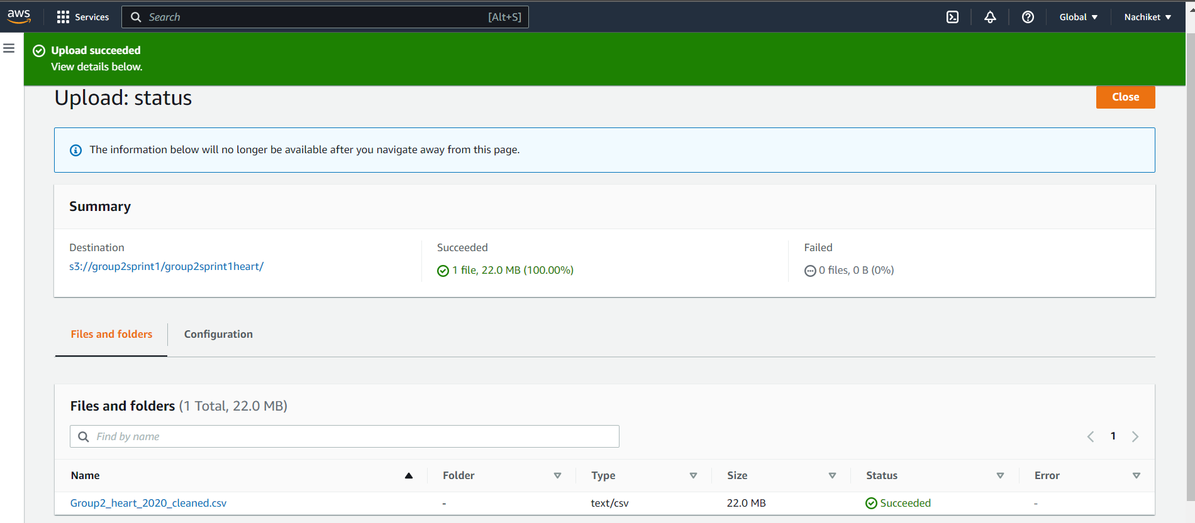

Slide 11

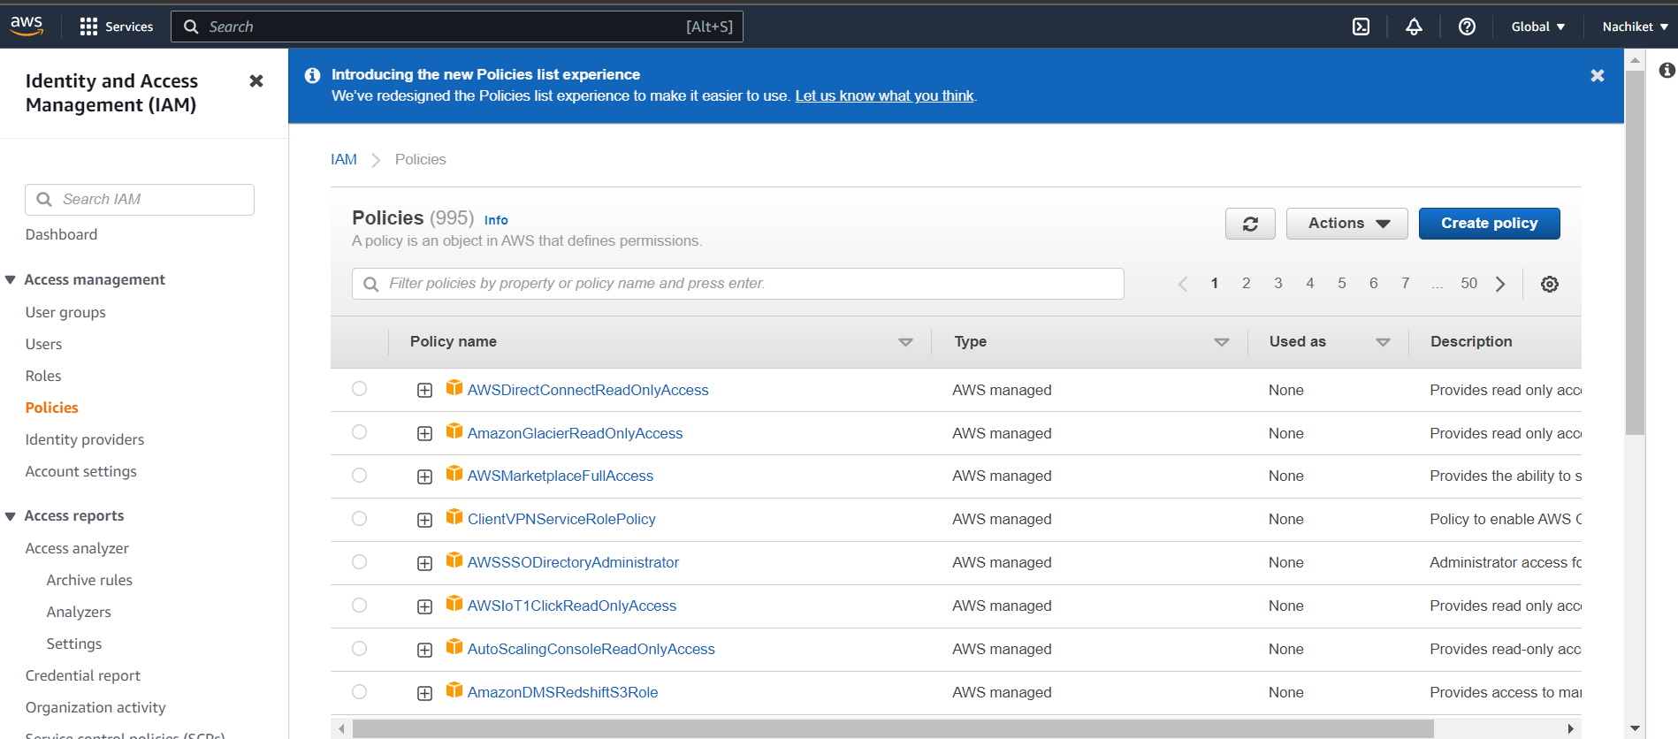
I AM: Identity and Access Management

Slide 12
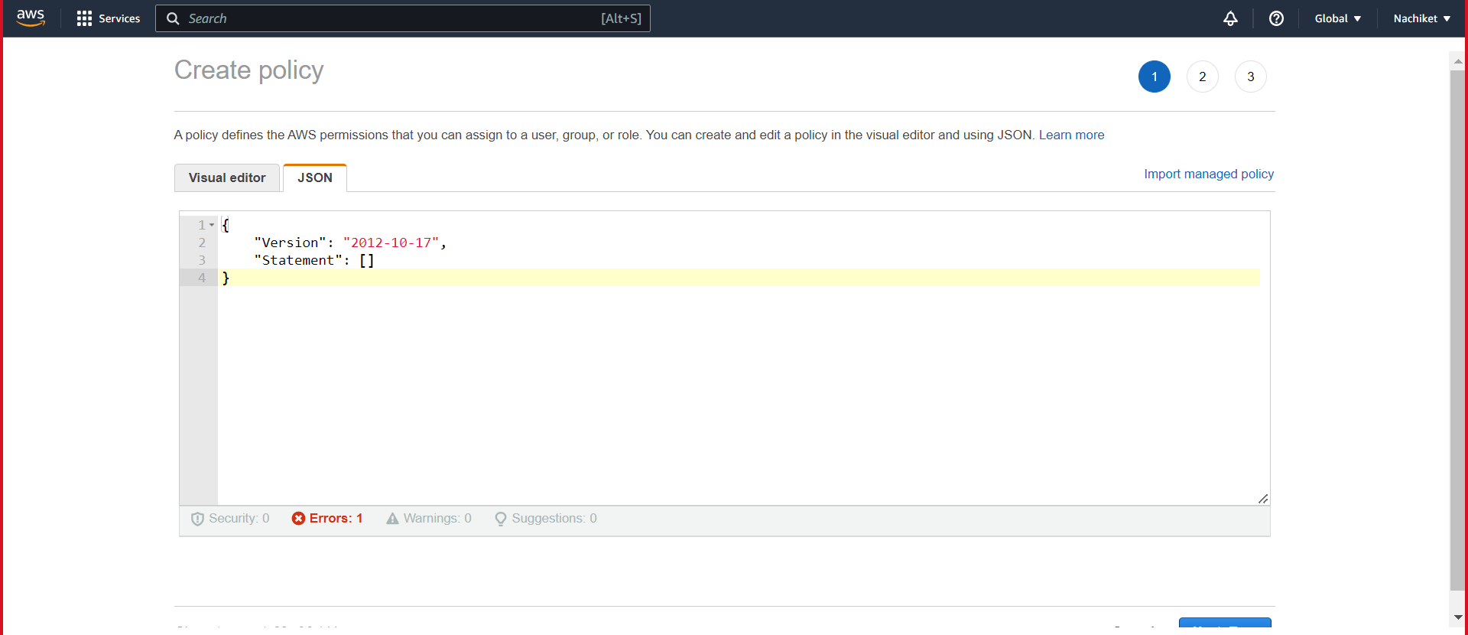

Slide 13
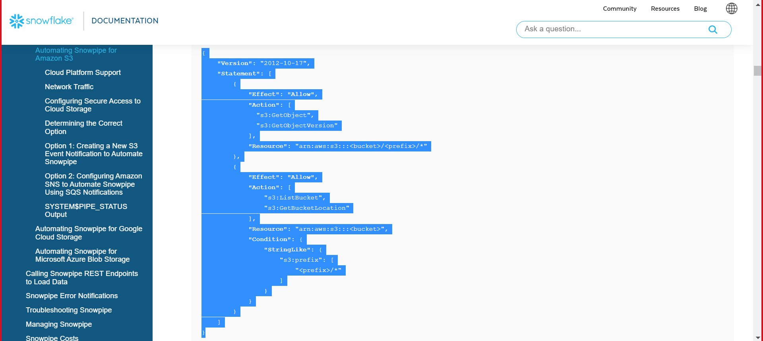

Slide 14
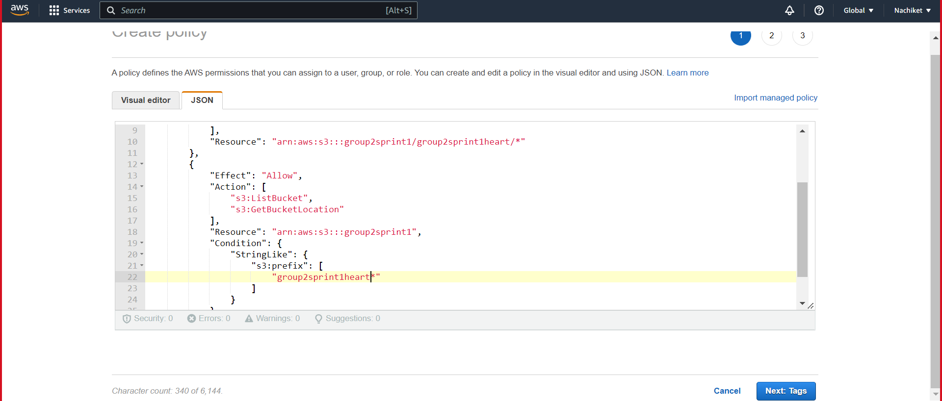

Slide 15
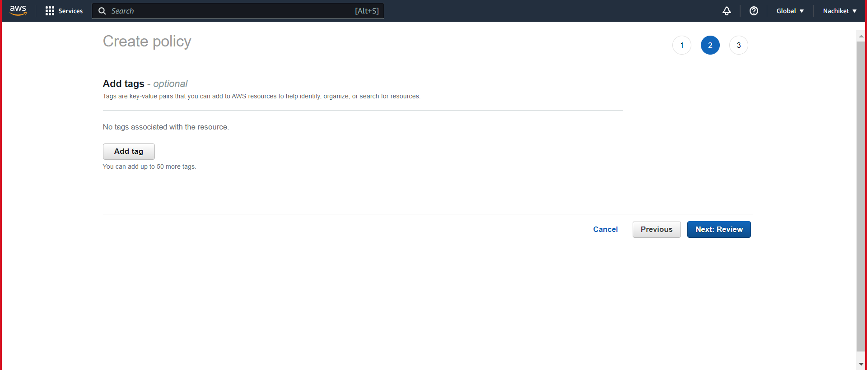

Slide 16
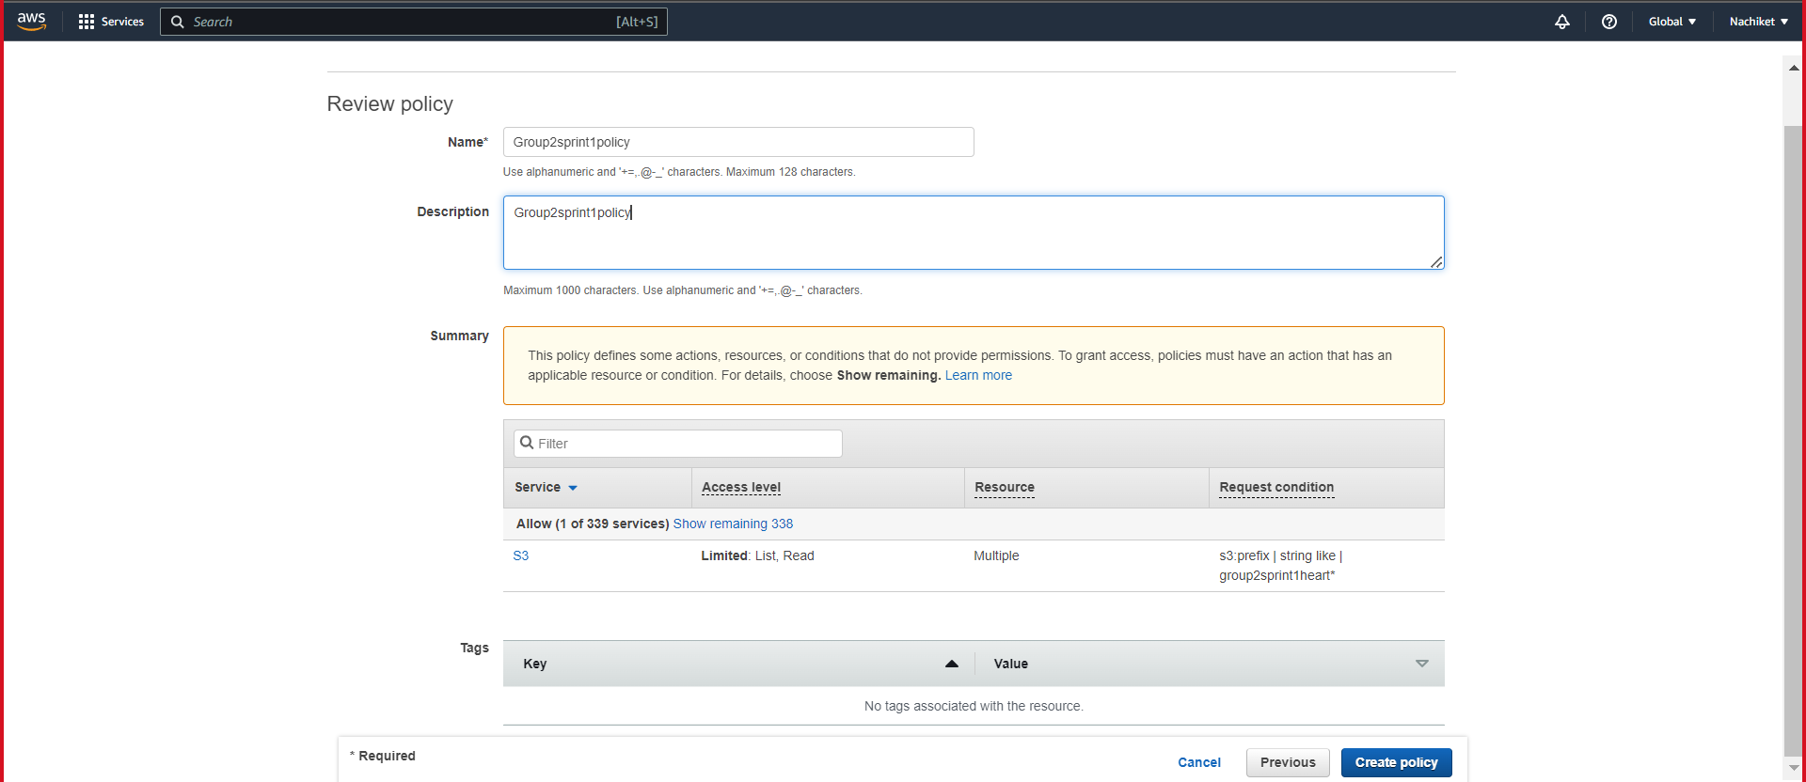

Slide 17
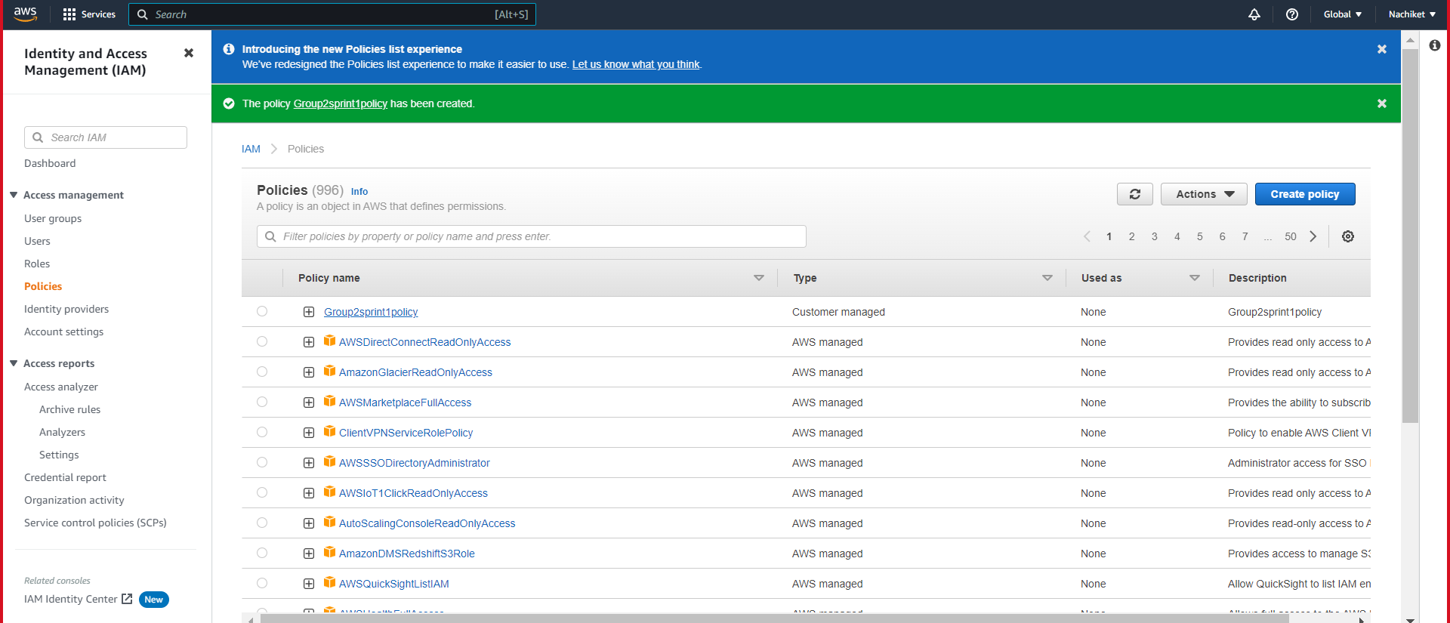

Slide 18
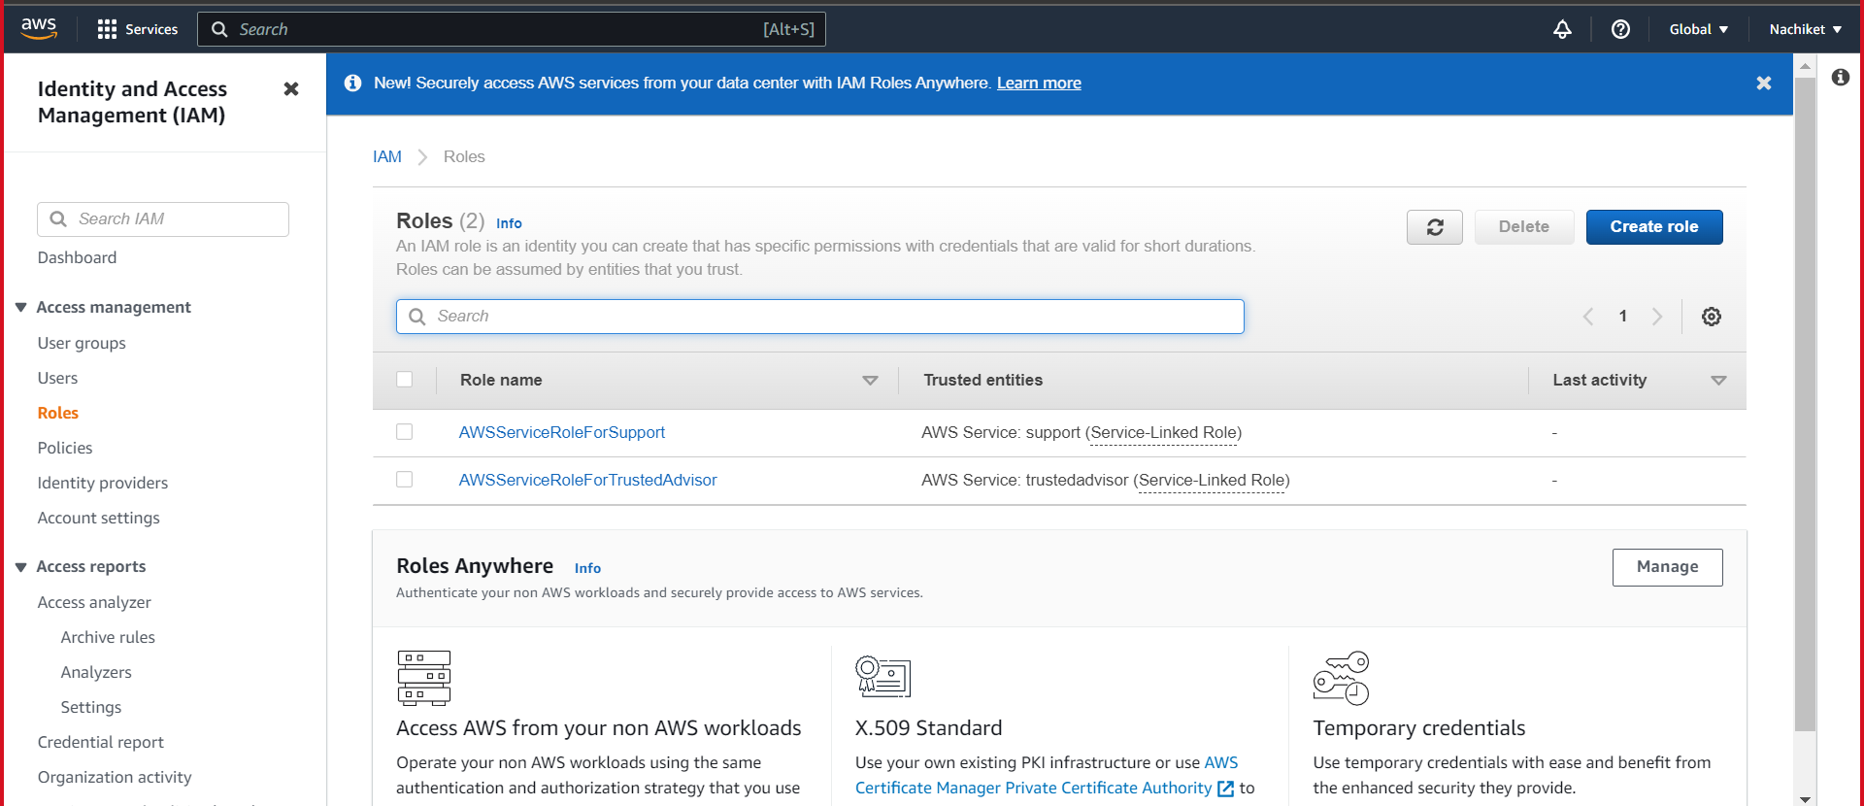

Slide 19
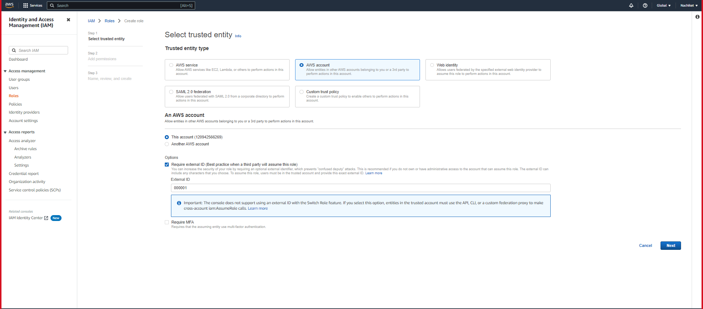

Slide 20
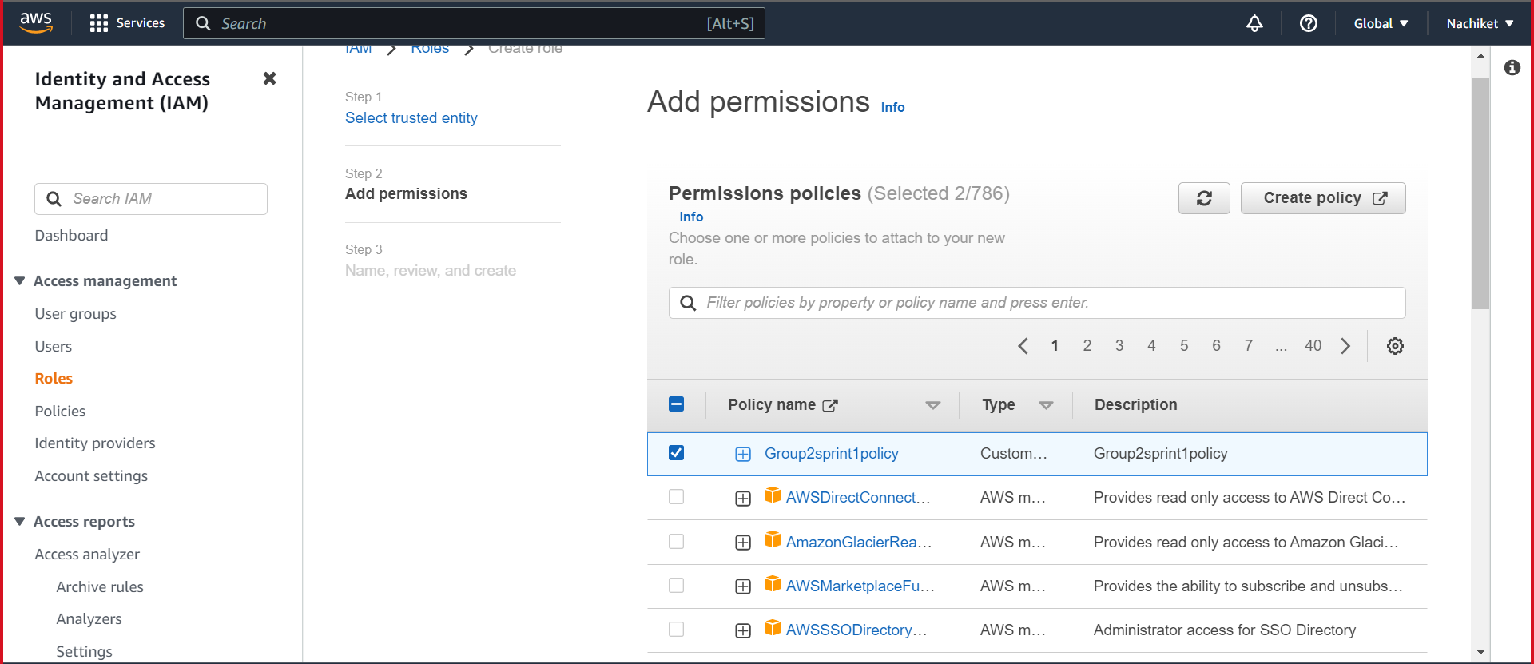

Slide 21
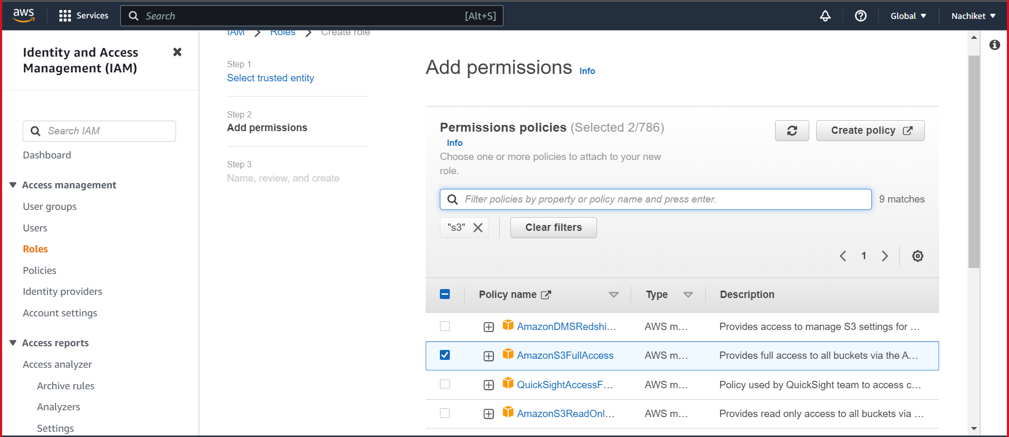

Slide 22
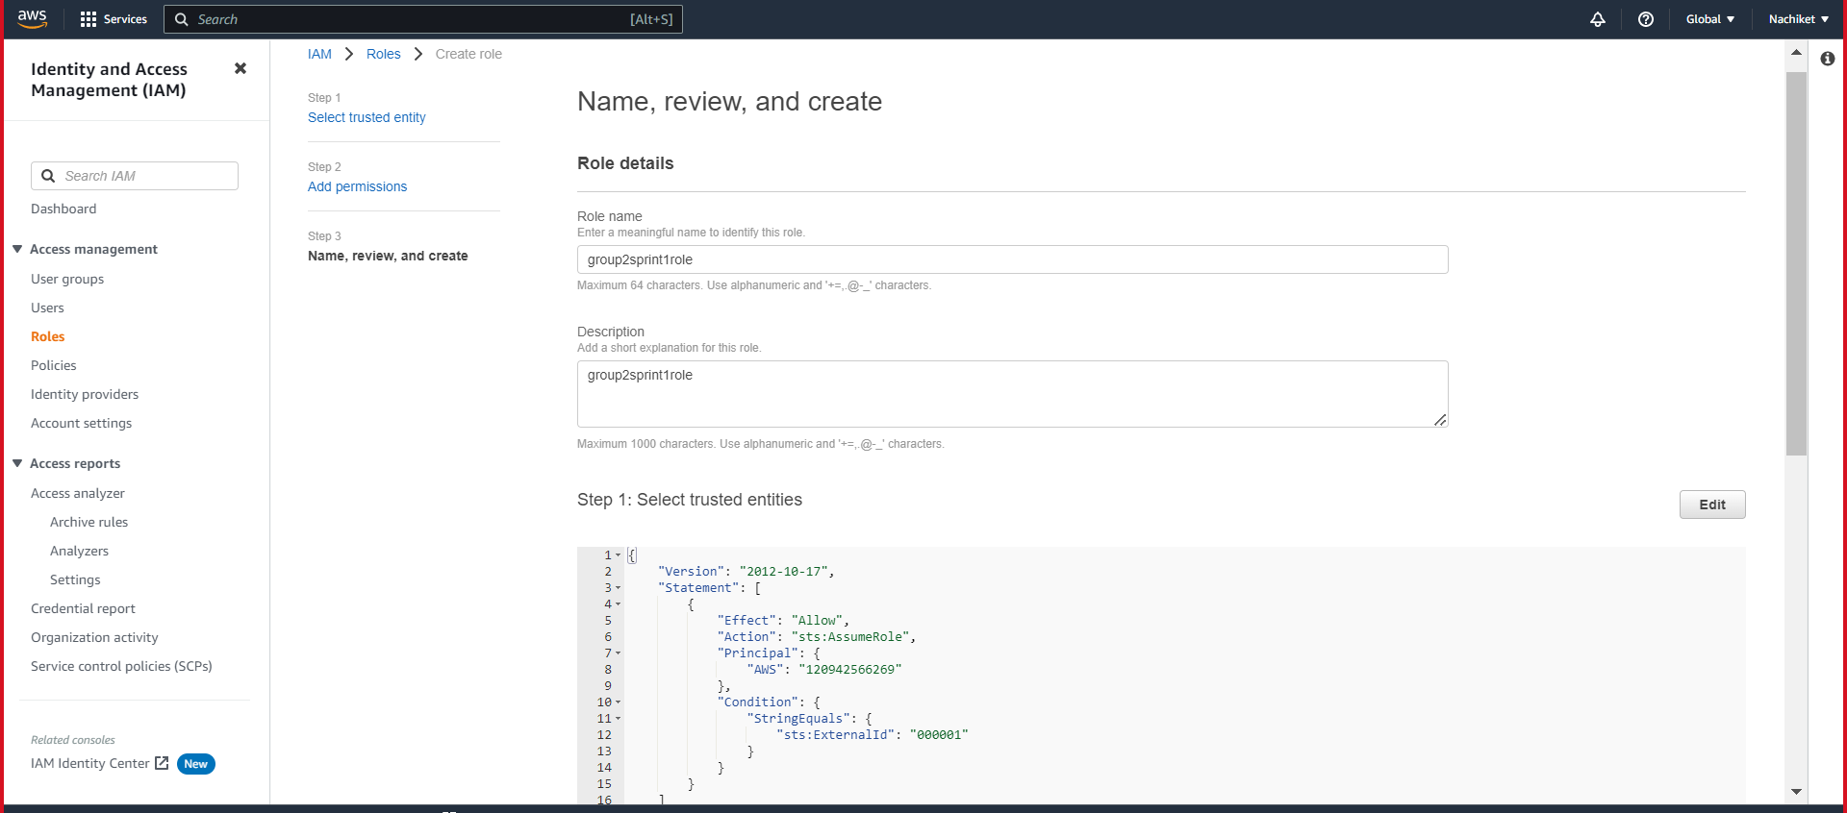

Slide 23
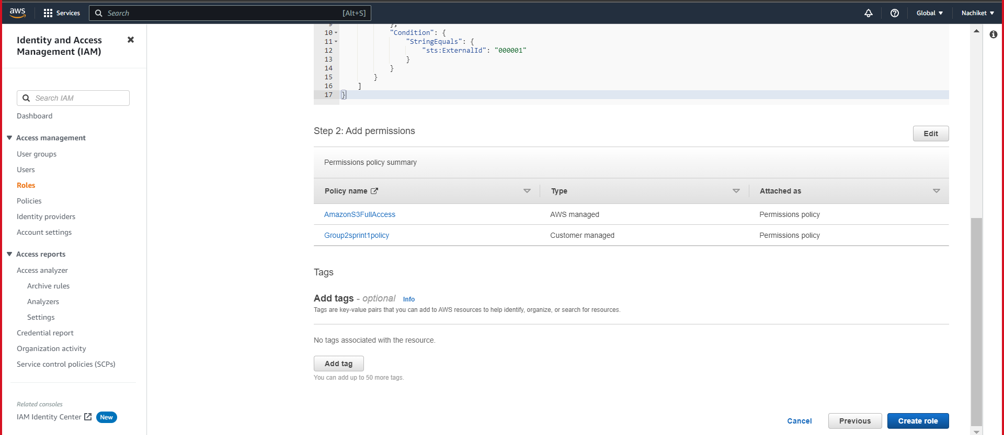

Slide 24
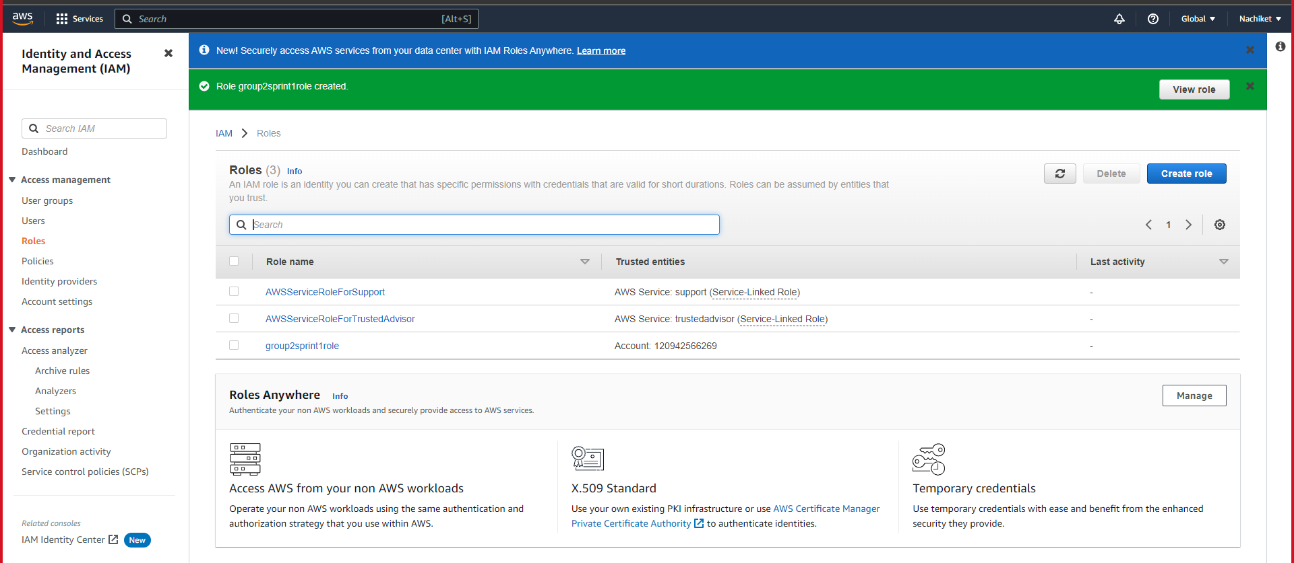

Slide 25
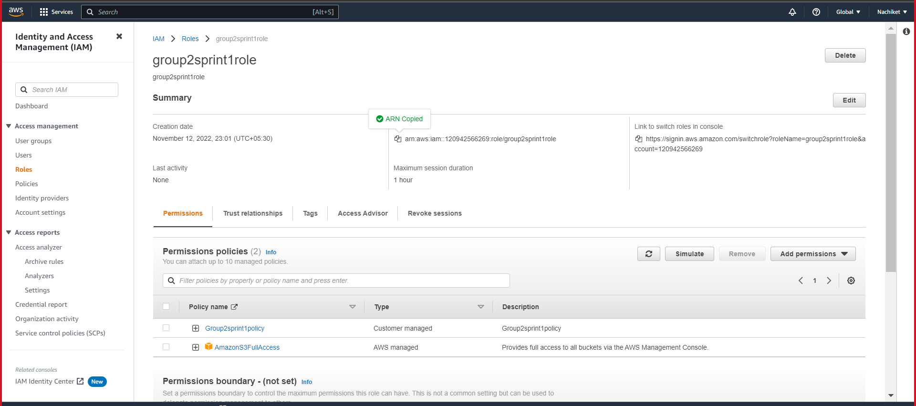

Slide 26
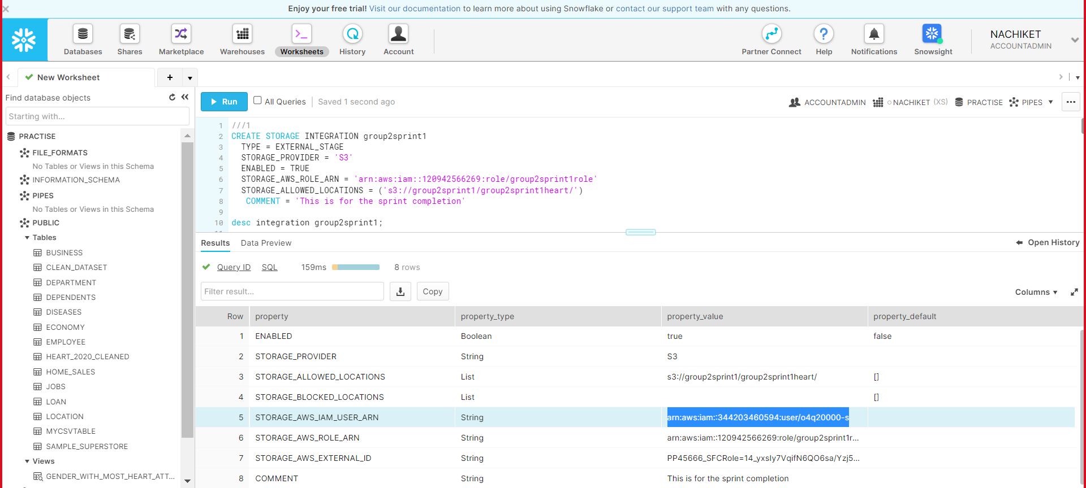

Slide 27
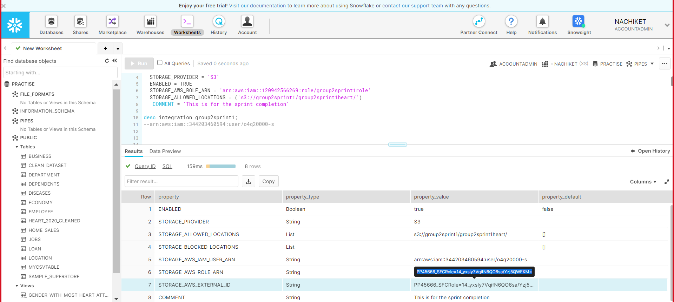

Slide 28
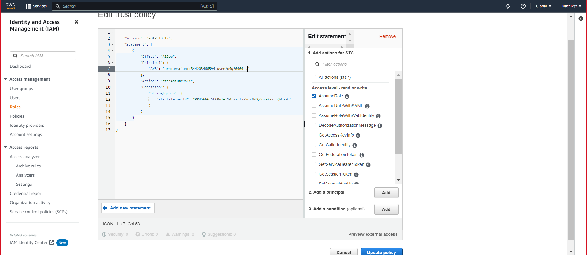

Slide 29
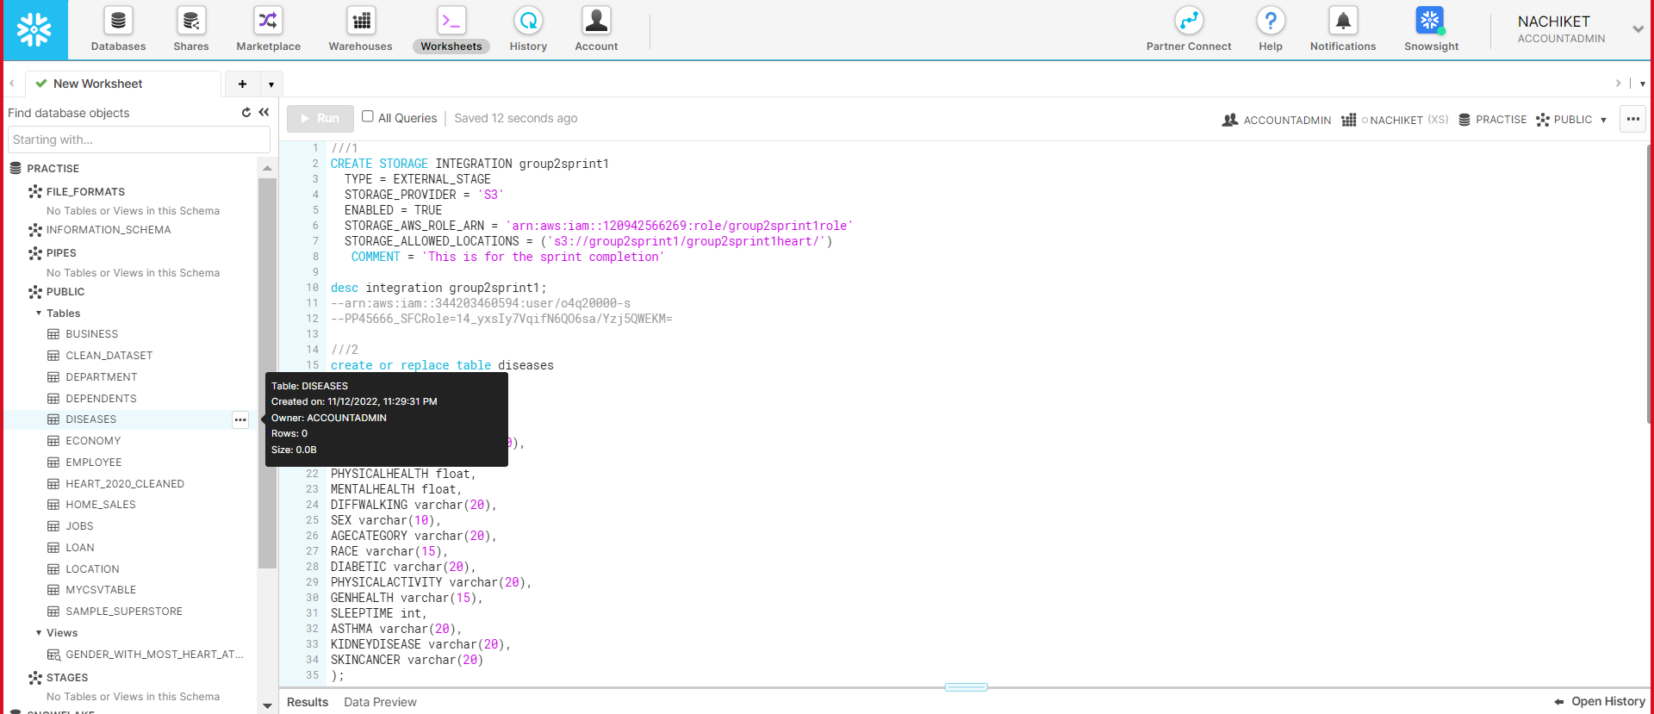

Slide 30
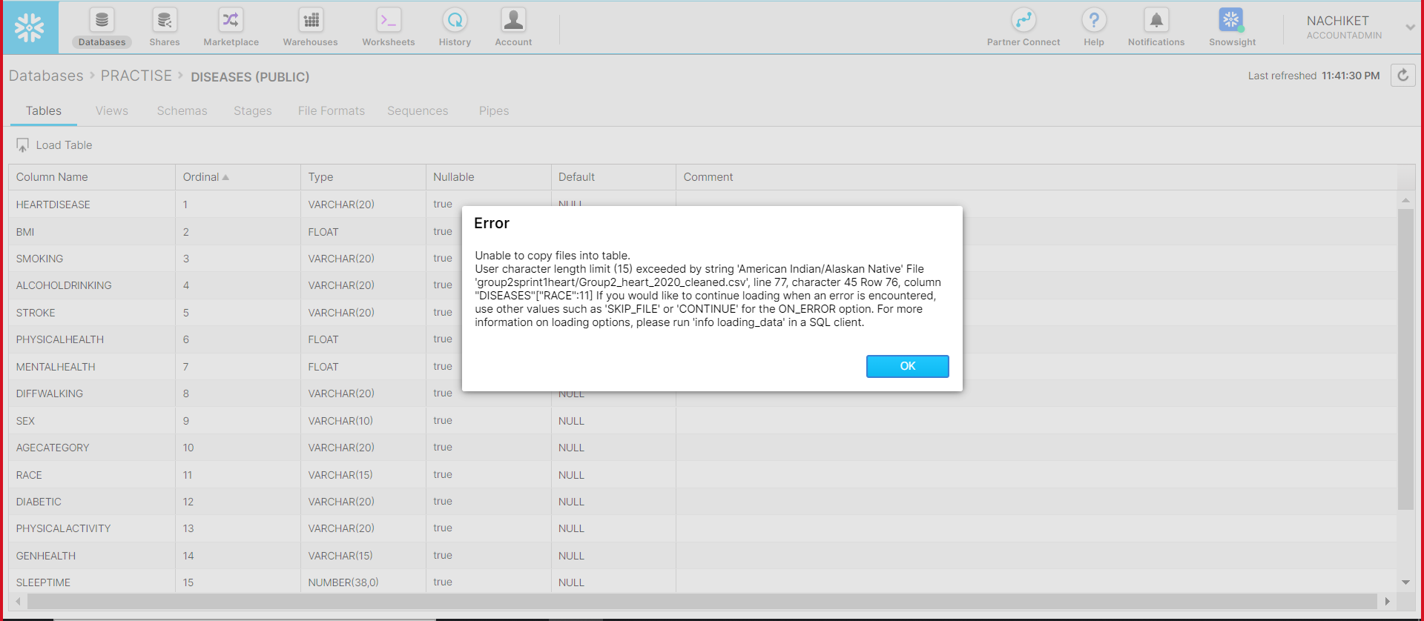

Slide 31
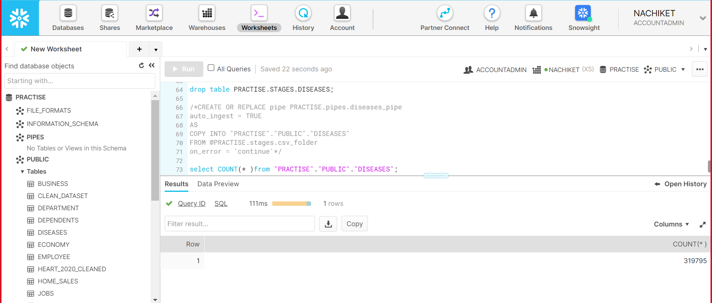

Slide 32
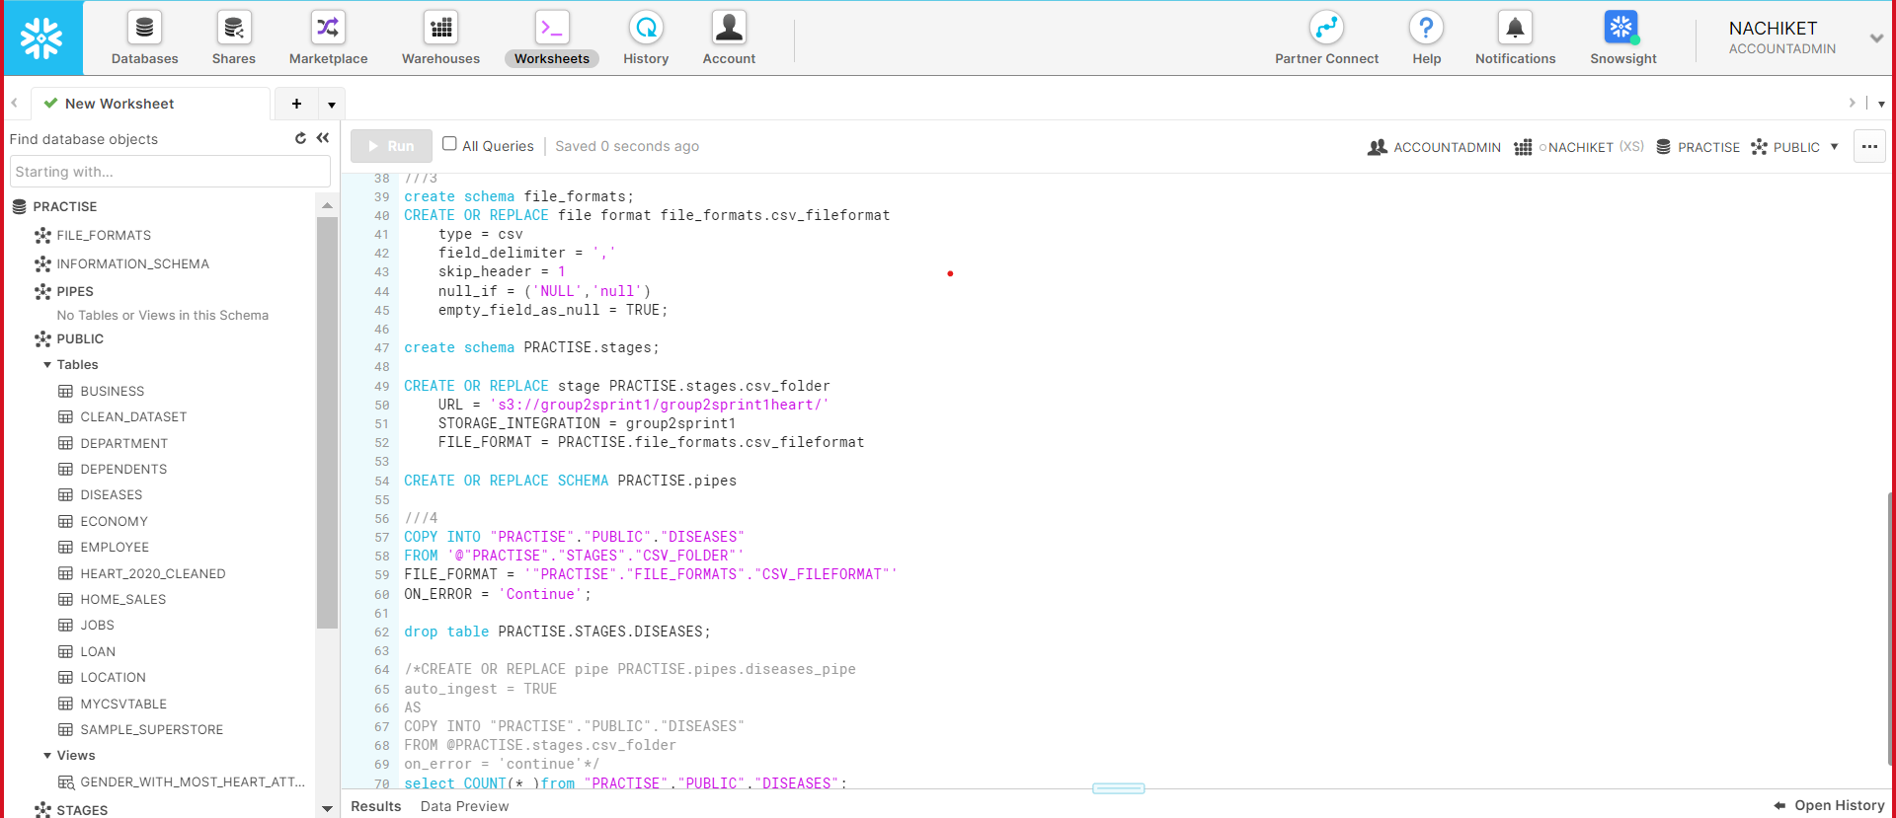

Slide 33
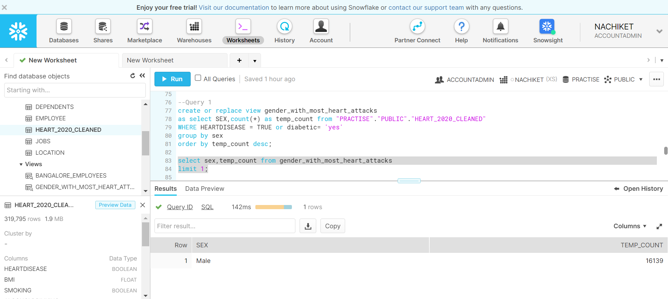
Q1. which gender have majority heart attack.

Slide 34
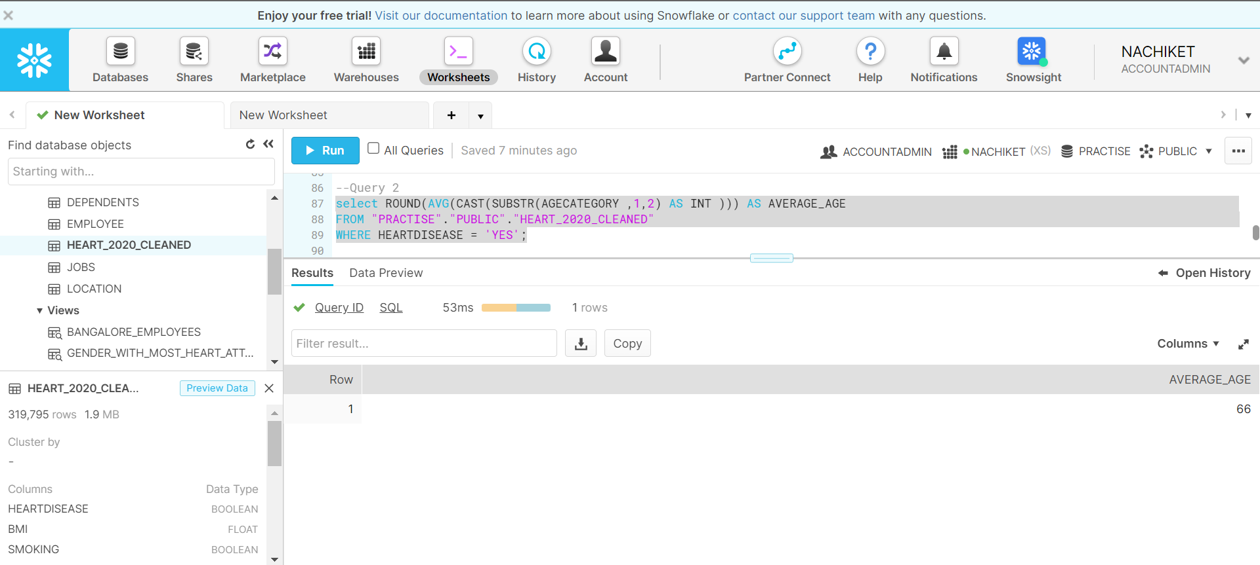
Q2. Average Age at which people generally gets heart attack.

Slide 35
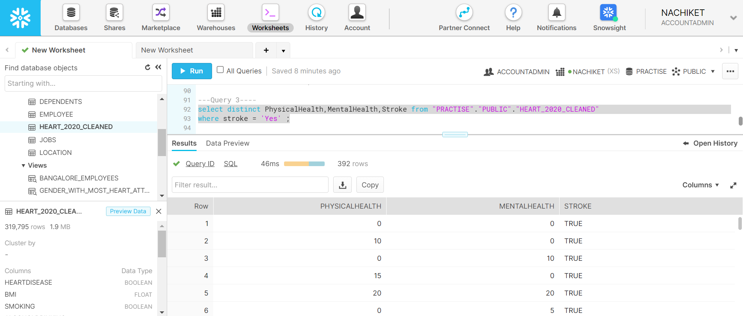
Q3. which combination of physical and mental health causes stroke.

Slide 36
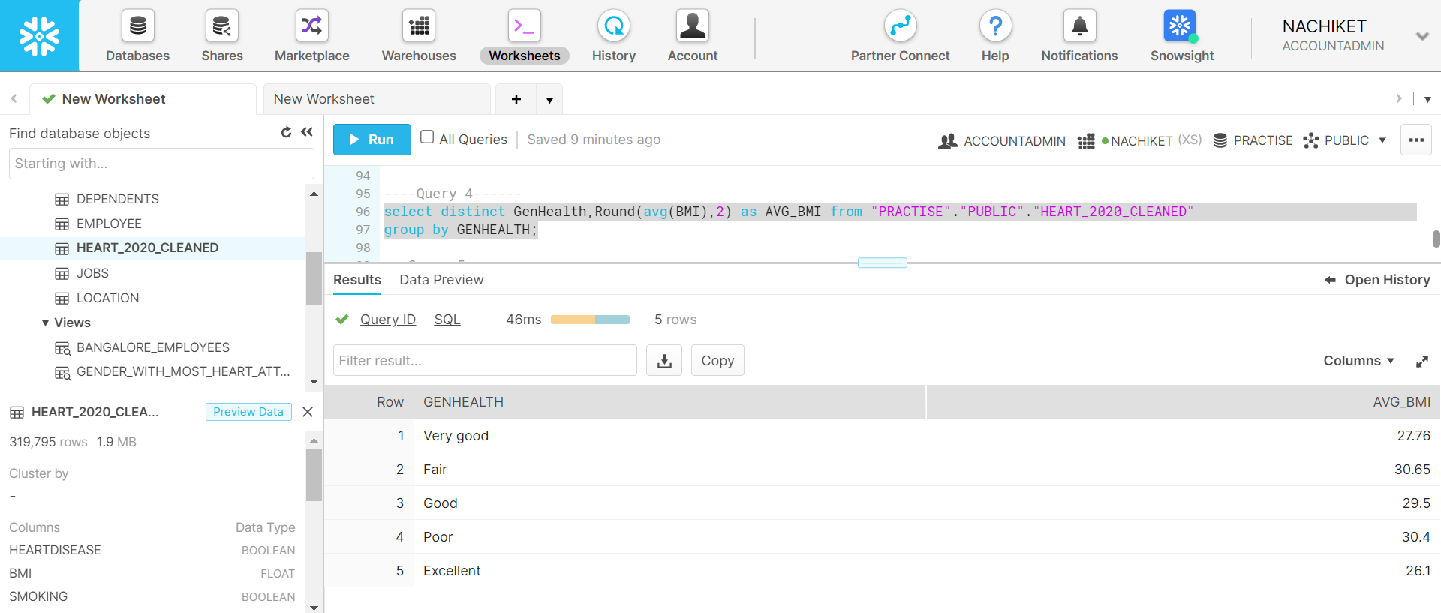
Q4. GenHealth wise average BMI of people.

Slide 37

Q5. Average age of people having problem in walking.

Slide 38
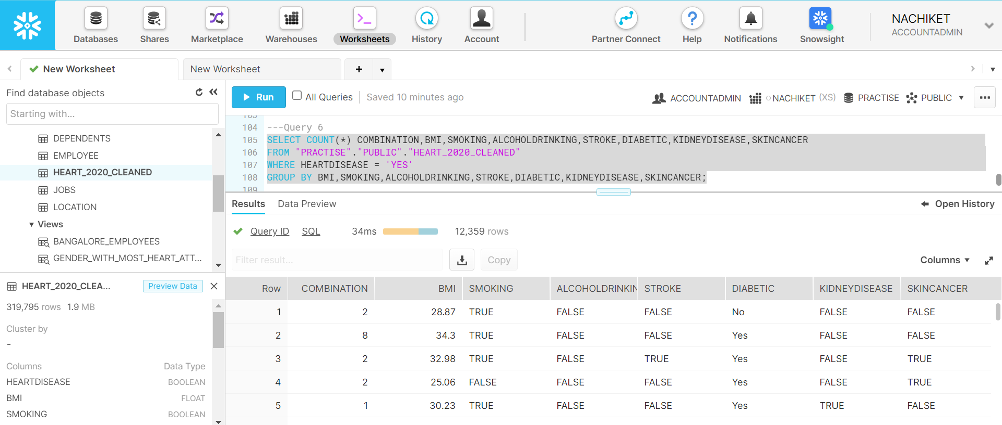
Q6. Count the different combination of people having heart-attack against BMI, Smoking , AlcoholDrink,Stroke,Diabetic,Kidney Diseases,skin cancer.

Slide 39

Q7. Average BMI of people having Skin Cancer

Slide 40
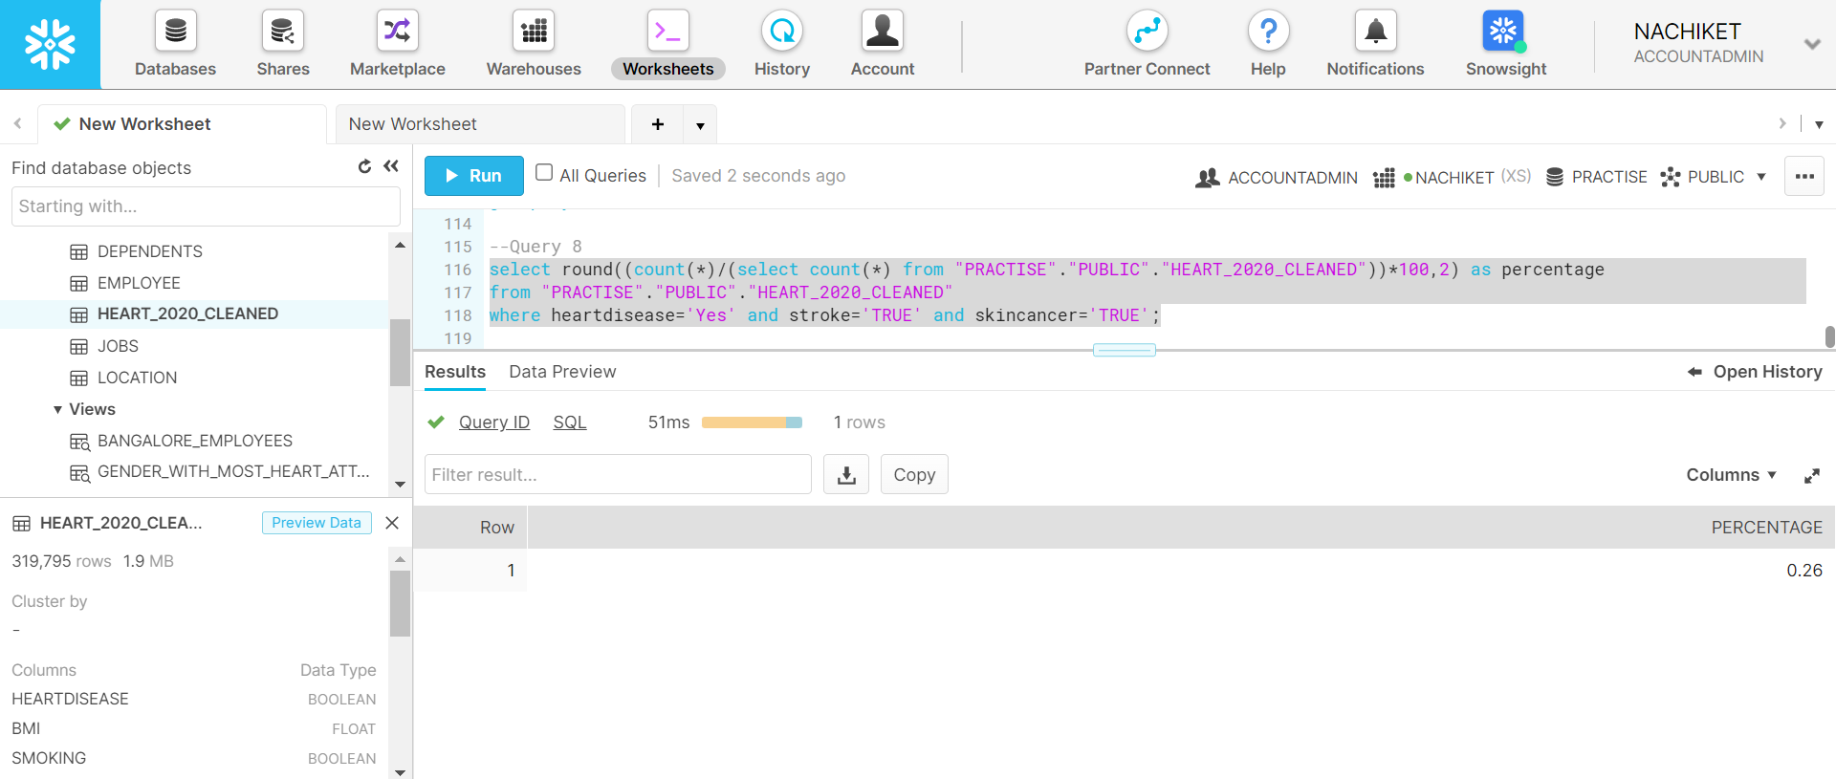
Q8. Possibilities/Percentage of people having both Heart Diseases stroke
and Skin Cancer

Slide 41
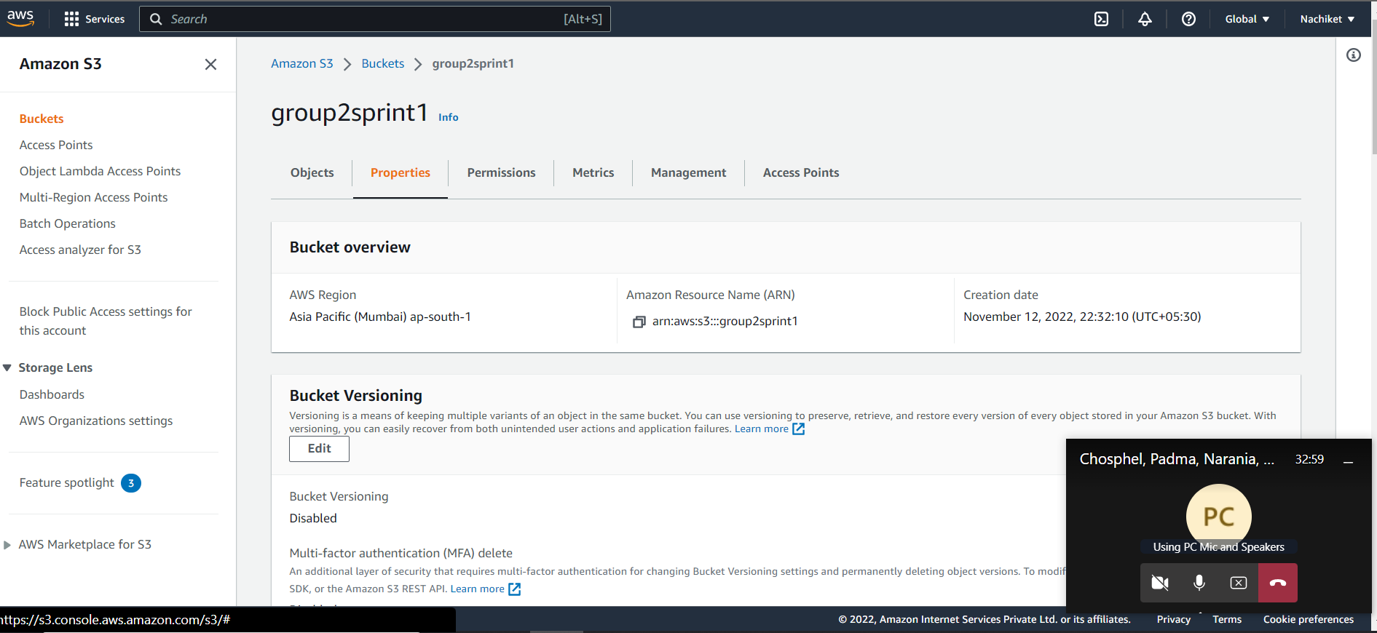

Slide 42
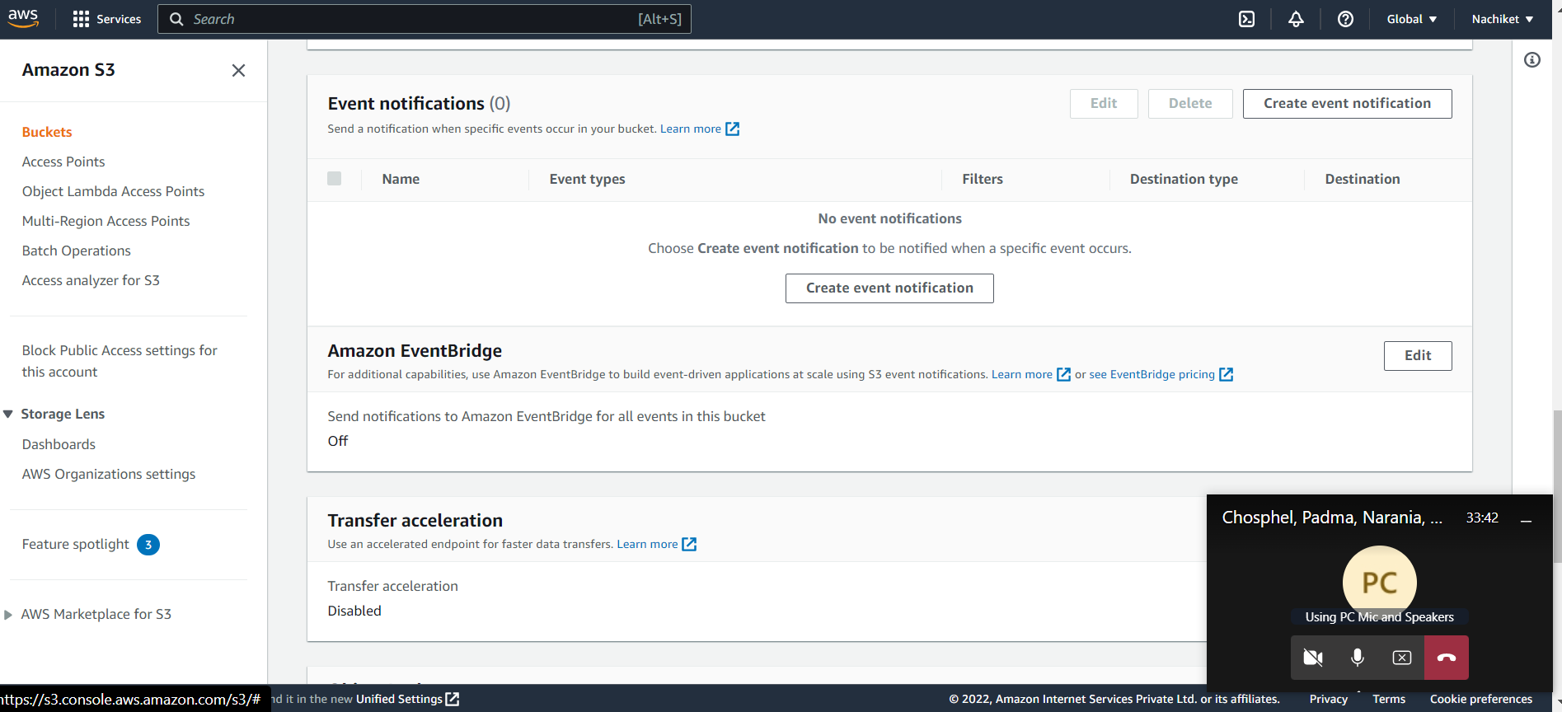

Slide 43
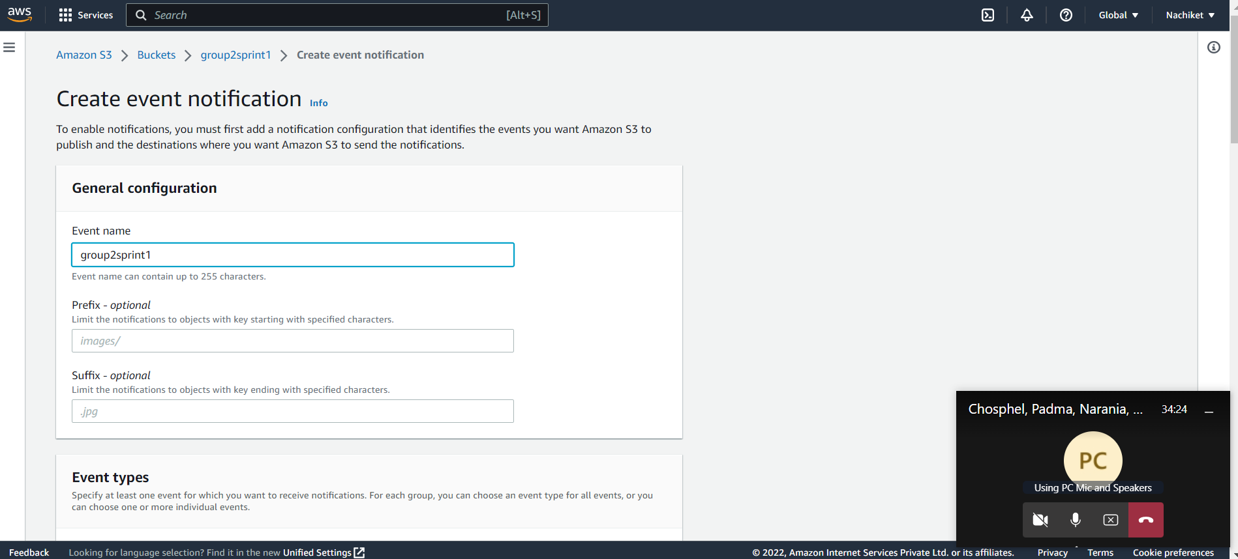

Slide 44
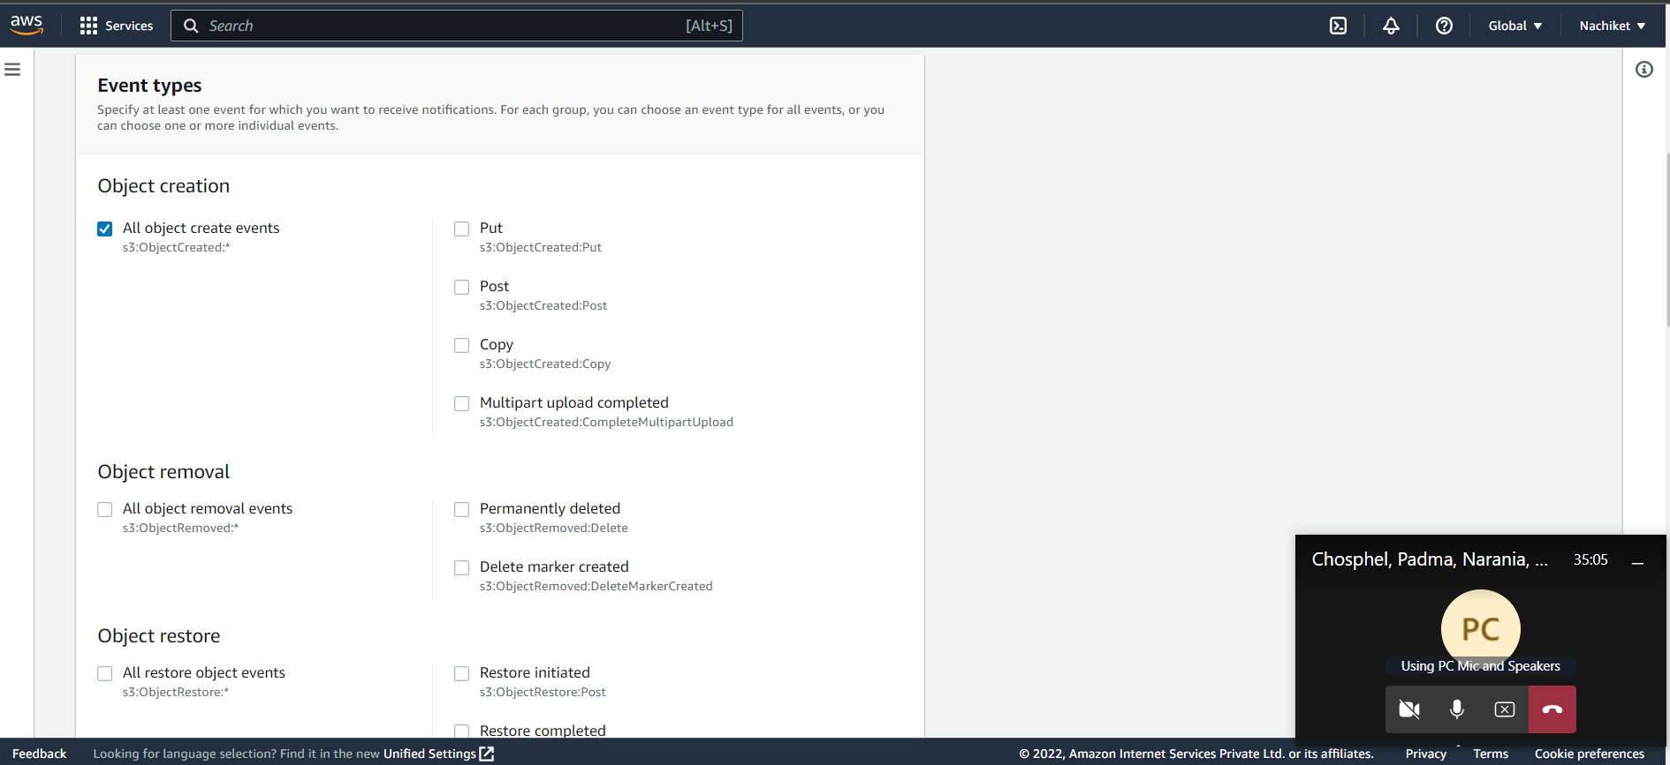

Slide 45
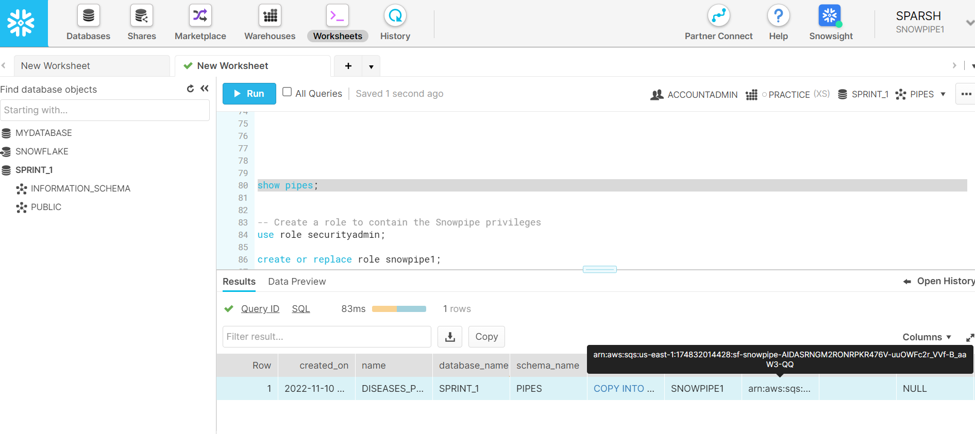

Slide 46
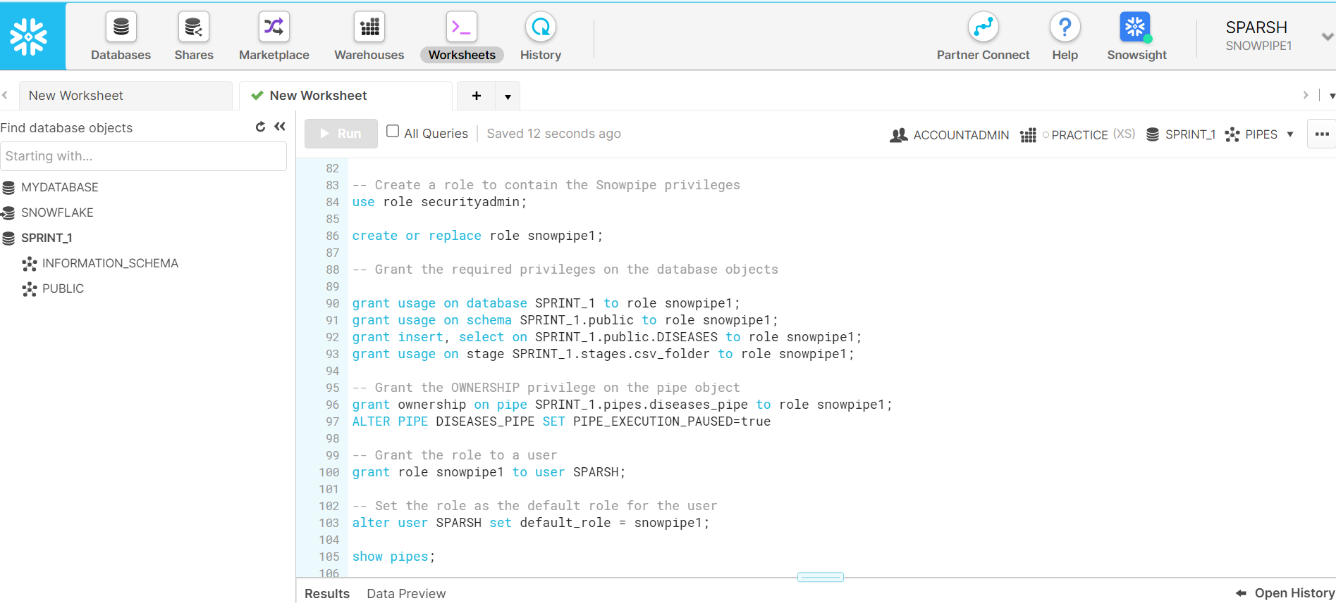

Slide 47
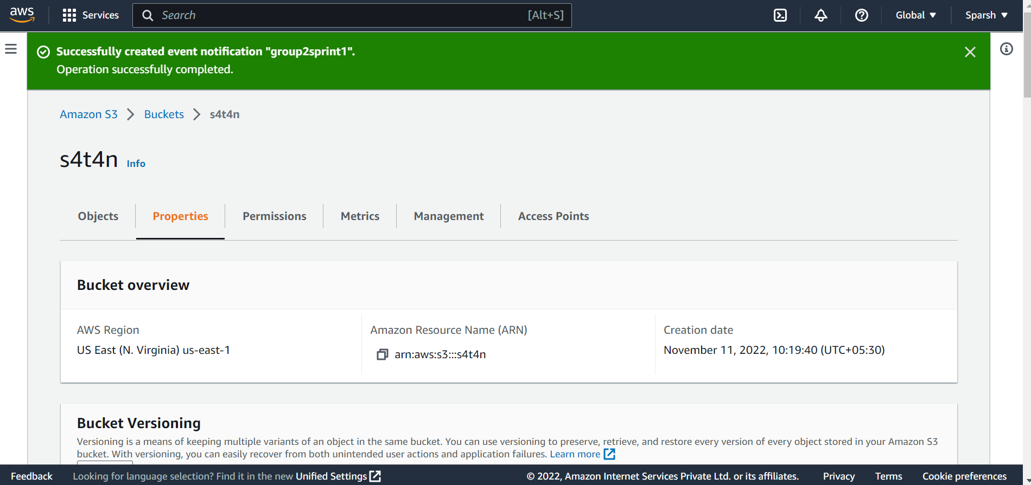

Slide 48
THANK YOU

